Slide 1
CHAPTER 6
Survey Research

Slide 2
Chapter Outline
Construct validity of surveys and polls
Construct validity of behavioral observations
Notes:
This chapter is about frequency claims and construct validity. The data for frequency claims come from either survey and polls or from behavioral observations, but researchers also can make other kinds of claims from these data. However, the focus of this chapter will be on how researchers use surveys and observations to measure one variable at a time for frequency claims.

Slide 3
Construct Validity of Surveys and Polls
Survey/poll
Choosing question formats
Writing well-worded questions
Encouraging accurate responses
Notes:
Survey/poll: For our purposes, these two terms mean the same thing. They are a method of asking people questions face-to-face, on the phone, on written questionnaires, or online.
The three main subsections in our discussion of the construct validity of surveys and polls are choosing question formats, writing well-worded questions, and encouraging accurate responses.

Slide 4
Choosing Question Formats
Open-ended questions
  What do you think of this class?
Forced-choice format
  Do you like this class so far? Yes or No
Likert scale
  How difficult is this class?
  Easy 1 2 3 4 5 Hard
Semantic differential format
Notes:
Survey questions come in a variety of formats.
Open-ended questions: Respondents may answer any way they like. Pro: They provide researchers with a lot of rich information. Con: Processing the coding and categorizing diverse responses can be difficult and time-consuming. Therefore, researchers sometimes restrict the answers that people provide in one of the following ways.
Forced-choice format: People provide their opinion by choosing the best of two or more options. They are used in political polls (for example, Which of the following candidates would you vote for for president?), for asking for opinions on current issues (for example, Do you think women should have the right to choose whether to have an abortion? Yes or No), or to determine a preference between two choices (for example, Which of these two statements describes you? I like to be the center of attention. It makes me uncomfortable to be the center of attention.).
Likert scale: People are presented with a statement and asked to use a rating scale to reflect their degree of agreement. A Likert scale is anchored by the terms strongly agree, agree, neither agree nor disagree, disagree, and strongly disagree. A Likert-type scale deviates slightly from this format.
Semantic differential format: Respondents are asked to rate a target object using a numeric scale anchored by adjectives (for example, rate your professor on level of difficulty on a scale from 1 [show up and pass] to 5 [hardest thing I’ve ever done]).

Slide 5
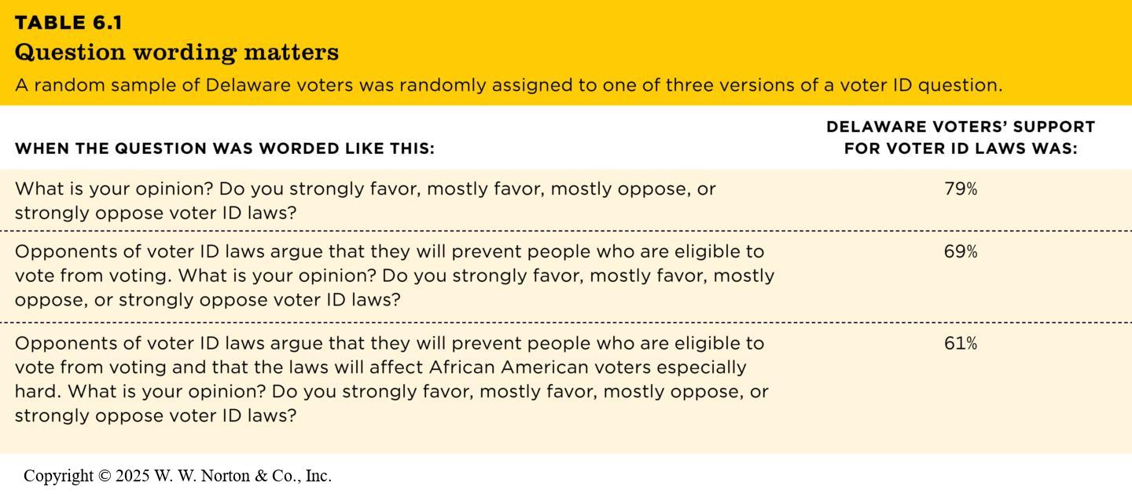
Writing Well-Worded Questions (1 of 2)
Table 6.1
TABLE 6.1 Question wording matters
A random sample of Delaware voters was randomly assigned to one of three versions of a voter ID question.
WHEN THE QUESTION WAS WORDED LIKE THIS: | DELAWARE VOTERS’ SUPPORT
FOR VOTER ID LAWS WAS:
What is your opinion? Do you strongly favor, mostly favor, mostly oppose, or strongly oppose voter ID laws? | 79%
Opponents of voter ID laws argue that they will prevent people who are eligible to vote from voting. What is your opinion? Do you strongly favor, mostly favor, mostly oppose, or strongly oppose voter ID laws? | 69%
Opponents of voter ID laws argue that they will prevent people who are eligible to vote from voting and that the laws will affect African American voters especially hard. What is your opinion? Do you strongly favor, mostly favor, mostly oppose, or strongly oppose voter ID laws? | 61%
Notes:
Table 6.1: Question Wording Matters
A random sample of Delaware voters was randomly assigned to one of three versions of a voter ID question.
Leading questions: Sometimes two questions seem to be asking the same thing but yield very different responses depending on how they are worded. (For example, of the two questions, How fast do you think the car was going when he hit the other car? and How fast do you think the car was going when he smashed into the other car?, which question do you think would lead people to give a higher speed estimate?) If the goal of a survey is to capture respondents’ true opinions, then questions should be worded as neutrally as possible.
Copyright © 2025 W. W. Norton & Co., Inc.

Slide 6
Writing Well-Worded Questions (2 of 2)
  Double-barreled question
  Do you enjoy swimming and wearing sunscreen?
  Negatively worded question
  People who do not drive with a suspended license should never be punished.
  Disagree 1 2 3 4 5 Agree
  Question order
Notes:
In order to interrogate the construct validity of a survey, we need to look at how well a variable was measured. To do this, we need to determine that the questions are clear and straightforward to answer.
Double-barreled questions: Asking two questions in one (for example, do you agree that the Second Amendment to the United States Constitution guarantees your individual right to own a gun and that the Second Amendment is just as important as your other constitutional rights? Do you [ ] support, [ ] oppose, or have [ ] no opinion?).
Negative wording: The more cognitively difficult a question is for people to answer, the more confusion there will be, which can reduce the construct validity of the item. Using double negatives can make questions more difficult for respondents to process. Consider the question, “Does it seem possible or does it seem impossible to you that the Nazi extermination of the Jews never happened?” In order to give your opinion about the Holocaust accurately, you must also be able to unpack the double negative of “impossible” and “never. “ Negatively worded questions can reduce construct validity by adding to the cognitive load, which may interfere with getting people’s true opinions.
Question order: Earlier items can influence the way respondents interpret later items. Suppose the first item on the survey is rather sensitive. That might influence the way respondents answer subsequent questions because they were “primed” by the first item. One way to control for order effects is to make different versions of the survey with questions in different orders.

Slide 7
Self-Administered Questionnaires
Questionnaires in which respondents are asked to complete the questionnaire by themselves.
Mail Distribution and Return
  Why do people not return questionnaires?
Online (weblink)

Slide 8
Self-Administered Questionnaires
Response Rate – The number of people participating in a survey divided by the number selected in the sample.
  Ideal = higher than 70%
  Why is a low response rate bad?
  What can be done to improve response?

Slide 9
Interview Surveys
Interview – A data-collection encounter in which one person (interviewer) asks questions of another (respondent).
Interviewers solicit higher response rates (80-85%) than mail surveys.
  Why?

Slide 10
Interview Surveys
Interviews minimized “don’t know” and “no answer.”
Interviewers serve as a guard against confusion.
Interviewers can observe respondents while completing the questionnaire.

Slide 11
Telephone Surveys
Advantages
  95.5% of households have at least one phone (landline, cell, etc.)
  Time and money
  Control
  Personal safety

Slide 12
Telephone Surveys
Disadvantages
  Unlisted phone numbers
  Cell phones
  Answering machines/voicemail/caller ID
  Representative?

Slide 13
Online Surveys
Online Surveys
  Available software and websites
  Finding respondents?
  Representative?

Slide 14
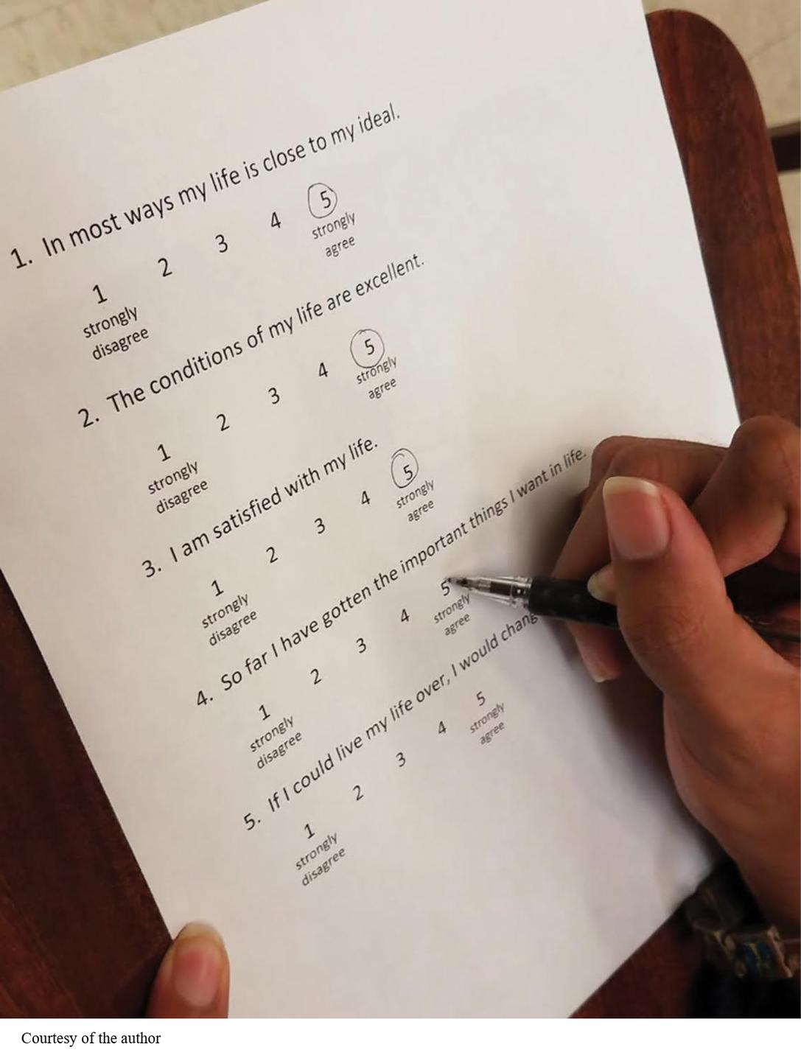
Encouraging Accurate Responses (1 of 2)
People can give meaningful responses
Sometimes people use shortcuts
  Response sets
  Acquiescence (yea-saying)
  Fence sitting
Notes:
Figure 6.4: Response Sets
When people use an acquiescent response set, they agree with almost every question or statement. It can be hard to know whether they really mean it or whether they’re just using a shortcut to respond to the questions.
Researchers want accurate answers from their respondents. What can they do to encourage this?
People can give meaningful responses: Can respondents ever provide accurate responses on surveys? Self-reports are sometimes ideal for getting demographic information about age, gender, ethnicity, income, and so on. In other cases, self-report might be your only choice (for example, What were you thinking about when I called your name?).
Sometimes people use shortcuts: Sometimes respondents use shortcuts when answering surveys, perhaps to finish them more quickly.
One such shortcut is a response set (aka nondifferentiation), which is a way of answering a number of questions in the same way (e.g., strongly agree). Response sets weaken construct validity because respondents aren’t saying what they really think.
Acquiescence (yea-saying) is a type of response set in which people answer positively (yes, strongly agree, agree) to a number of items instead of looking at each item individually. For example, a respondent might answer “5” to every item on Diener’s scale of subjective well-being., not because they are a happy person, but rather because they are using a yea-saying shortcut. People apparently have a bias to agree with (say “yes” to) any item—no matter what it states (Krosnick, 1999). Acquiescence can threaten construct validity because instead of measuring the construct of true feelings of well-being, the survey could be measuring the tendency to agree or the lack of motivation to think carefully.
Fence sitting: Another shortcut is to play it safe by choosing the response in the middle of the scale for all items. This is referred to as fence sitting. This might involve providing a neutral response or responding, “I don’t know.” Fence sitting weakens construct validity when respondents actually have a positive or negative opinion, but their responses indicate neutrality. It is difficult to distinguish fence sitters from those who truly feel neutral. One solution is to remove the neutral (center) option so there are an even number of options. Another solution is to use forced choice.
Courtesy of the author

Slide 15
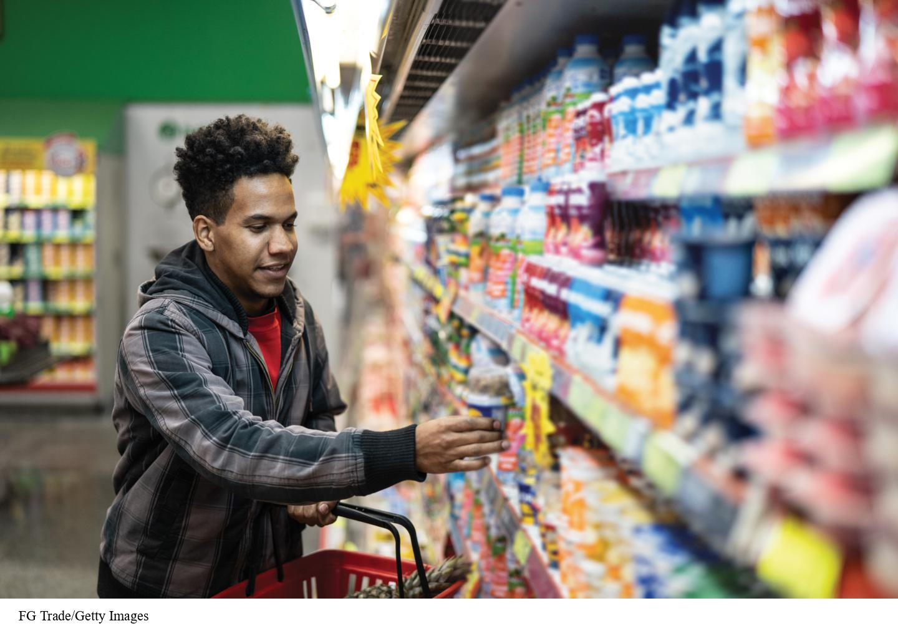
Encouraging Accurate Responses (2 of 2)
Trying to look good
  Socially desirable responding/faking good
  Faking bad (Malingering)
Self-reporting “more than they can know”
Self-reporting memories of events
Rating consumer products
Notes:
Figure 6.5: The Accuracy of Self-Reports
If you ask this shopper why he chooses one of these items, he will probably give you a reasonable answer. But does his answer represent the true reason for making his choice?
Trying to look good: Most of us like to look good in other people’s eyes, so why shouldn’t this extend to the way we respond on surveys?
Socially desirable responding/faking good: Trying to look better than we are (smarter, stronger, thinner, happier, more successful).
Faking bad: This is less common, but sometimes respondents try to look bad (more aggressive, more deviant, nastier). One way to avoid this is to remind respondents that their responses are anonymous. However, sometimes this results in respondents not taking the survey seriously if they know their names won’t be attached to it. Might include special items in the survey to identify socially desirable responders. Can also ask people’s friends to rate them. Researchers also can use computerized measures to evaluate implicit attitudes about sensitive topics (for example, the Implicit Association Test [IAT]).
Self-reporting “more than they can know”: Are people capable of reporting accurately about their feelings, thoughts, and behavior? For example, if I ask you why you always buy a particular brand of yogurt, you might not really know why, yet you may tell me something that sounds reasonable.
Self-reporting memories of events: What about self-reporting memories of behaviors? For example, when was the last time you took your car to the car wash? What were you wearing on your 21st birthday? Where were you and what were you doing when you got your acceptance letter to this college or university? People’s memories for events are not as accurate as they might like to believe. Furthermore, confidence and accuracy are not related. People might feel very confident about what they report, even if they’re not accurate.
Rating consumer products: One study found little correspondence between five-star ratings on Amazon and the ratings of the same products by Consumer Reports, an independent product-rating firm (De Langhe et al., 2016). Researchers found that consumers' ratings were, instead, correlated with the cost of the product and the prestige of its brand. Studies like these suggest that people may not always be able to accurately report on the quality of products they buy.
FG Trade/Getty Images

Slide 16
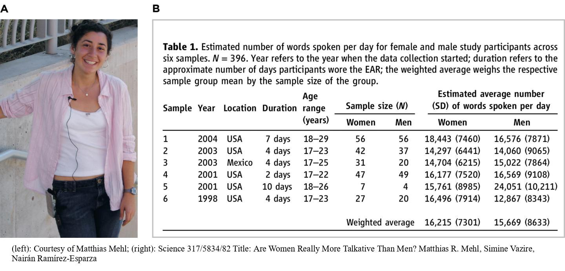
Construct Validity of Behavioral Observations
  Observational research
  Some claims based on observational data
  Observing how much people talk
Notes:
Figure 6.7: Observational Research on Daily Spoken Words
(A) Study participants wore a small recording device to measure how many words they spoke per day. (B) This table shows the study’s results as they were reported in the original empirical journal article. (Source: Mehl et al., 2007, Table 1.)
Another type of data that can be used to support a frequency claim is data from observational research (in which a researcher watches people or animals and systematically records their actions). Many researchers think that observing behavior is better than relying on self-report, given the issues we’ve discussed with the accuracy of self-report. As has already been mentioned, observational research can be the basis of frequency claims (e.g., how often do people eat in fast-food restaurants?). Observational research can also be used for association claims and causal claims. Regardless of the kind of claim you’re making, it’s important that your observational measures be high in construct validity.
Examples of frequency claims based on data from observational research:
Observing how much people talk: Researcher Matthias Mehl, at the University of Arizona, has developed an electronically activated recorder (EAR) to observe what people say in everyday conversations. The EAR has a microphone and a digital recording device. Every 12.5 minutes the EAR records for 30 seconds. Then research assistants transcribe what the person said while being recorded. Mehl and his colleagues found that despite stereotypes of women being more talkative than men, women did not use significantly more words than men as recorded by the EAR (Mehl et al., 2007).
(left): Courtesy of Matthias Mehl; (right): Science 317/5834/82 Title: Are Women Really More Talkative Than Men? Matthias R. Mehl, Simine Vazire, Nairán Ramírez-Esparza

Slide 17
Some Claims Based on Observational Data
Observing where babies and caregivers look
Observing sibling interactions
Observations can be better than self-reports
Notes:
Figure 6.9: Coding Sibling Interactions
Two siblings collaborate on the grocery store task in a study by Alcalá et al. (2018).
Alcala, Rogoff, Fraire, PNAS 11/5/18 https://doi.org/10.1073/pnas.1805707115
Figure 6.10: Results of the Sibling Interaction Study
Researchers coded each sibling pair’s collaboration strategy in 10-second increments. Each column of the figure represents one sibling pair—there were 14 U.S. Mexican Indigenous–heritage sibling pairs and 16 U.S. Middle-class European–American sibling pairs. Each small horizontal segment represents one 10-second increment. The dominant color on each half indicates which strategy tended to be used in each cultural group. (Source: Alcalá et al., 2018).
Observing where babies and caregivers look: When researchers recorded and analyzed where babies and their caregivers were looking in the laboratory playroom, they found that the babies looked at the toys more often, while their caregivers looked equally at the toys and the babies (Franchak et al., 2016).
Observing sibling interactions: In this research, siblings from dual-earner families were followed by a camera crew from the time they returned from school until 8 p.m. (Alcalá et al., 2018). Then a variety of behaviors were coded from the videotapes, including the emotional tone of the siblings and the topics of their interactions during shared activities. Emotional tone: rated each sibling on a 7-point scale from 1 (cold/hostile) to 7 (warm/friendly). Emotional tone was moderately positive (4.5/7). Context of interactions: Younger siblings were more likely to seek help with homework or share stories about school, whereas older siblings were more likely to give advice or discuss future plans.
Alcala, Rogoff, Fraire, PNAS 11/5/18 https://doi.org/10.1073/pnas.1805707115

Slide 18
Making Reliable and Valid Observations (1 of 2)
Making reliable and valid observations
Observer bias: when observers see what they expect to see
Notes:
Let’s look at the advantages of behavioral observations over self-report.
Making reliable and valid observations: We always need to be concerned with the construct validity of observations, and the construct validity can be threatened by observer bias, observer effects, and reactivity.
Observer bias: When observers’ expectations influence their interpretations of participants’ behaviors or the outcome of the research. Observers rate behaviors according to their own expectations or hypotheses instead of rating behaviors objectively. Let’s say that we all watched a videotape of a man in his mid-20s being interviewed. Before viewing the video, half of you were told that the man was a graduate student, and half of you were told that he was a criminal. Do you think this might influence your opinions of this man?

Slide 19
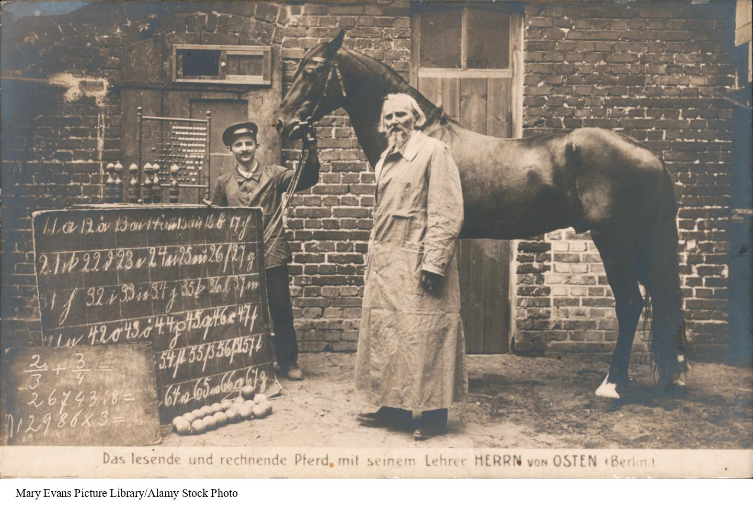
Making Reliable and Valid Observations (2 of 2)
Observer effects: when participants confirm observer expectations
  Bright and dull rats
  Clever Hans
Notes:
Figure 6.11: William van Osten and Clever Hans
The horse Clever Hans could detect nonverbal gestures from anybody—not just his owner—so his behavior even convinced a special commission of experts in 1904 that he was capable of doing math.
Observer effects: when observers change the behavior of the participants to match the observer’s expectations; also known as expectancy effects.
Bright and dull rats: Psychology undergraduates were given five rats and told to see how long it took for the rats to learn to run a maze (Rozenthal & Fode, 1963) . Each student was given a randomly selected group of rats. Half of the students were told that their rats were bred to be “maze-bright” and half were told they were bred to be “maze-dull.” The rats were actually all genetically similar, but the “maze-bright” rats ran the maze faster each day with fewer mistakes, whereas the “maze-dull” rats did not improve their performance over several days of testing. The study demonstrated that sometimes observers’ expectations can influence the behavior of those they’re observing.
Clever Hans: Clever Hans was a horse who could add, subtract, multiply, and divide at least as well as a fifth-grader. Hans was tutored in simple mathematics by his trainer and would tap his hoof to count. Moreover, the trainer was not the only person who could get Hans to do this type of math. Researchers suspected that Hans was picking up on subtle nonverbal cues from his questions, so they had one person whisper the first part of the problem in Hans’s ear and a second person whisper the second part of the math problem. Neither questioner knew the correct answer because they only knew the part of the problem they whispered, and in fact, Hans could not answer these math questions. Yes, Hans was clever, but not in math. He was skilled at detecting subtle nonverbal cues (such as changes in breathing, changes in posture, and furrowed eyebrows).
Mary Evans Picture Library/Alamy Stock Photo

Slide 20
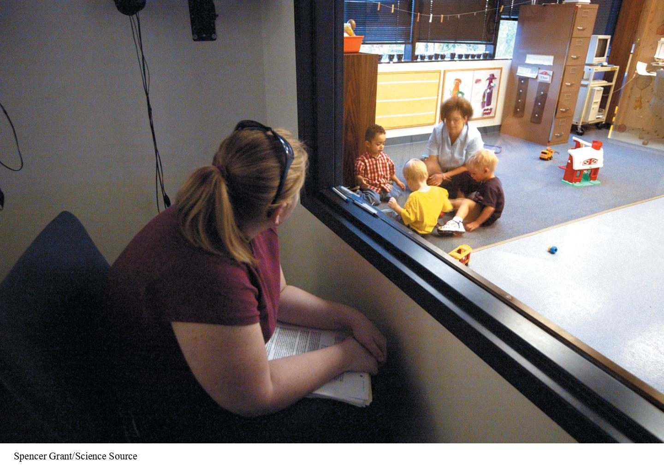
Reactivity: When Participants React to Being Watched
Solution 1: Blend in
  Unobtrusive observations
Solution 2: Wait it out
Solution 3: Measure the behavior’s results
Notes:
Figure 6.13: Unobtrusive Observations
This one-way mirror lets researchers unobtrusively record the behaviors of children in a preschool classroom.
Reactivity: when people change their behavior in some way when they know that someone else is watching them. For example, let’s say you want to do some observational research in a preschool setting. If you simply walked in one day and sat down in the classroom to begin your observations, the children and teachers might change their behavior in a variety of ways. The children might be curious about what you’re doing there and ask you a lot of questions. Some children might be afraid of you. The teachers might feel their teaching is being assessed. What should a good researcher do to prevent reactivity?
Solution 1: Blend in. Make yourself less obvious by sitting in the back of the classroom or by being in an adjacent room behind a one-way mirror in a setting that’s designed for such observations. The goal is to make unobtrusive observations to prevent reactivity.
Solution 2: Wait it out. Sometimes it’s a good idea to have research participants get used to your presence by visiting a number of times so that they become more familiar with you being around.
Solution 3: Measure the behavior’s results. Instead of actually measuring behaviors, sometimes researchers obtain unobtrusive data by measuring traces of a behavior. For example, if you were interested in the amount and types of junk food that college students eat in the dorm, you could look at the wrappers in the dorm’s garbage cans.
Spencer Grant/Science Source

Slide 21
Observing People Ethically
Is it ethical for researchers to observe the behaviors of others?
  Short answer: It depends.
Notes:
Whether or not it’s ethical for researchers to observe the behavior of others depends on the situation. Most researchers think it’s ethical to observe people’s behavior in public places such as at concerts, on campus, and at the bus stop. Scientists don’t specifically identify the people they observe when they report their research findings. The use of one-way mirrors or hidden cameras might be considered ethical in some situations. But in order to observe people’s private behaviors, researchers need to get permission in advance.

Slide 22
Ethics and Survey Research
Surveys often ask for private information, which must be kept confidential.
Because asking questions can cause psychological discomfort or harm to respondents, researchers should minimize this risk.

Slide 23
Finding Psychological Questionnaires
Google Scholar
International Personality Item Pool (IPIP)

